Slide 1
Introduction to Information Retrieval

Slide 2
Definition of Information Retrieval System
An Information Retrieval System is a system that is capable of storage, retrieval, and maintenance of information.
Information in this context can be composed of text (including numeric and date data), images, audio, video and other multi-media objects.
While there are many other ways to build an object in an information retrieval system, so far only text has shown to be a data type that is well suited for complete functional processing.
  The other data types have been treated as highly informative sources, but are primarily linked for retrieval based upon search of the text.

Slide 3
Definition of Information Retrieval System
The term “item” is used to represent the smallest complete unit that is processed and manipulated by the system.
  A complete document, such as a book, newspaper or magazine could be an item. At other times each chapter, or article may be defined as an item.
  An item may address even lower levels of abstraction such as a contiguous passage of text or a paragraph.
  A video news program could be considered an item. It is composed of text in the form of closed captioning, audio text provided by the speakers, and the video images being displayed.
    There are multiple "tracks" of information possible in a single item.
  They are typically correlated by time.

Slide 4
Definition of Information Retrieval System
An Information Retrieval System consists of a software program that facilitates a user in finding the information the user needs.
The system may use standard computer hardware or specialized hardware to support the search sub-function and to convert non-textual sources to a searchable media (e.g., transcription of audio to text).
An information system's ability to reduce the overhead (time required to find the information needed, excluding the time for actually reading the relevant data. )required for a user to locate the information they need is a key indicator of its success.
Thus search composition (preparation/ the manufacturing process), search execution, and reading non-relevant items are all aspects of information retrieval overhead.

Slide 5
Definition of Information Retrieval System
A new way to access terabytes of information has been made possible by the advent and exponential growth of the Internet, as well as its original WAIS (Wide Area Information Servers) capacity and more current advanced search servers (like INFOSEEK and EXCITE).
The processing and access of large quantities of textual data have now become a needed capability for large quantities of the population with significant research and development being done by the private sector.
Images across the Internet are searchable from many web sites such as WEBSEEK, DITTO.COM, ALTAVISTA/IMAGES.

Slide 6
Difference between information retrieval system and dbms
Information Retrieval is concerned with the representation, storage, organization of, and access to information items.
The main difference between databases and IR is that databases focus on structured data while IR focuses mainly on unstructured data
Also, databases are concerned with data retrieval, not information retrieval.

Slide 7
Objectives of Information Retrieval Systems
The general objective of an Information Retrieval System is to minimize the overhead of a user locating needed information.
  Overhead can be expressed as the time a user spends in all of the steps leading to reading an item containing the needed information (e.g., query generation, query execution, scanning results of query to select items to read, reading non-relevant items).
The information required and the user's willingness to absorb overhead determine how successful an information system will be.
Under some circumstances, needed information can be defined as all information that is in the system that relates to a user’s need.
  In other cases it may be defined as sufficient information in the system to complete a task, allowing for missed data.

Slide 8
Objectives of Information Retrieval Systems
A system that supports reasonable retrieval requires fewer features than one which requires comprehensive retrieval.
  In many cases comprehensive retrieval is a negative feature because it overloads the user with more information than is needed.
  This makes it more difficult for the user to filter the relevant but non-useful information from the critical items.
In information retrieval the term “relevant” item is used to represent an item containing the needed information.
In reality the definition of relevance is not a binary classification but a continuous function.

Slide 9
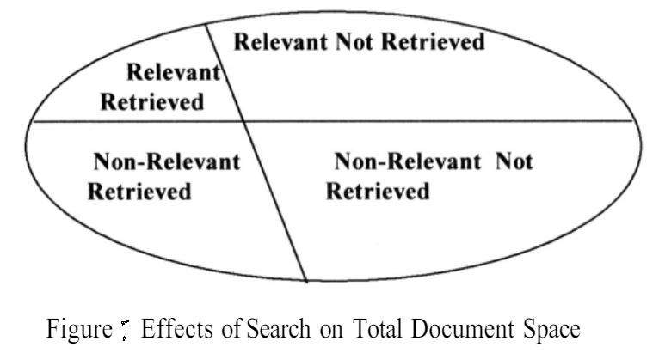
Objectives of Information Retrieval Systems
The two major measures commonly associated with information systems are precision and recall.
When a user decides to issue a search looking for information on a topic, the total database is logically divided into four segments shown in Figure:
Relevant items are those documents that contain information that helps the searcher in answering his question. Non-relevant items are those items that do not provide any directly useful information. There are two possibilities with respect to each item:
  it can be retrieved or not retrieved by the user’s query.

Slide 10
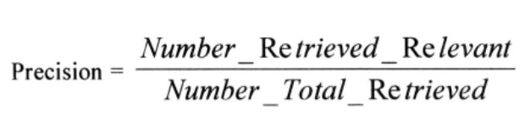
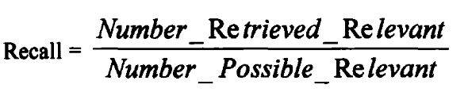
Objectives of Information Retrieval Systems
Precision and recall are defined as:
where
  Number_Possible_Relevant are the number of relevant items in the database.
  Number_Total_Retieved is the total number of items retrieved from the query.
  Number_Retrieved_Relevant is the number of items retrieved that are relevant to the user’s search need.

Slide 11
Objectives of Information Retrieval Systems
Precision: Precision measures how many of the retrieved items are relevant to the user's query.
  It is calculated as the ratio of relevant items retrieved to the total items retrieved. For example, if a search has 85% precision, it means 85% of the items retrieved are relevant, and 15% are non-relevant (which represent overhead for the user).
Recall: Recall measures how well the system retrieves all the relevant items from the database that the user is interested in.
  It is calculated as the ratio of relevant items retrieved to the total number of relevant items in the database.
  A high recall indicates that the system is good at finding all relevant items.

Slide 12
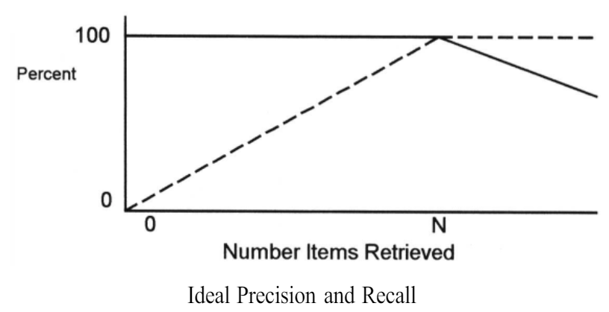
Objectives of Information Retrieval Systems
Relationship between Precision and Recall:
  In an ideal scenario (Figure), where every retrieved item is relevant, precision starts at 100% (because initially all retrieved items are relevant) and gradually decreases as more non-relevant items are retrieved. Recall, on the other hand, starts low and increases as more relevant items are found, until all relevant items in the database have been retrieved.
  Once all relevant items have been retrieved, recall reaches 100% because no more relevant items can be retrieved.
  Precision is affected by the retrieval of non-relevant items; as more non-relevant items are retrieved, precision drops.
  Recall, however, is not affected by the retrieval of non-relevant items; it only concerns how many of the relevant items were successfully retrieved out of all possible relevant items.
Recall is not directly calculable in operational systems because it requires knowledge of the total set of relevant items in the database, which may not be known beforehand. Thus, operational systems often estimate or infer recall indirectly based on the retrieved items.
precision and recall are crucial metrics in evaluating the effectiveness of information retrieval systems, with precision focusing on the relevance of retrieved items and recall focusing on the completeness of retrieval for relevant items.

Slide 13
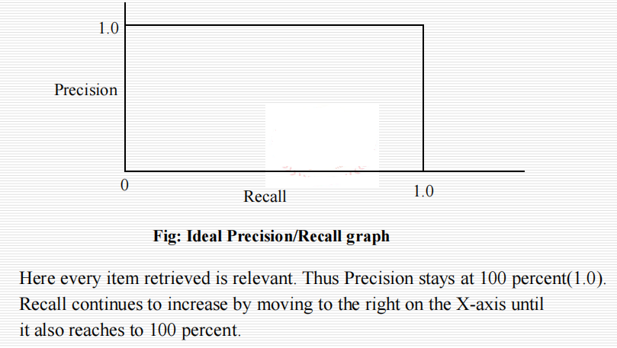
Objectives of Information Retrieval Systems

Slide 14
Objectives of Information Retrieval Systems
The first objective of an Information Retrieval System is support of user search generation.
There are natural obstacles to specification of the information a user needs that come from ambiguities inherent in languages, limits to the user’s ability to express what information is needed and differences between the user’s vocabulary corpus and that of the authors of the items in the database.
Natural languages suffer from word ambiguities such as homographs and use of acronyms that allow the same word to have multiple meanings (e.g., the word “field” )
Disambiguation techniques exist but introduce significant system overhead in processing power and extended search times and often require interaction with the user.

Slide 15
Objectives of Information Retrieval Systems
Many users have trouble in generating a good search statement. The typical user does not have significant experience with nor even the aptitude for Boolean logic statements.
It is only with the introduction of Information Retrieval Systems such as RetrievalWare, TOPIC, AltaVista, Infoseek and INQUERY that the idea of accepting natural language queries is becoming a standard system feature
This allows users to state in natural language what they are interested in finding. But the completeness of the user specification is limited by the user’s willingness to construct long natural language queries. Most users on the Internet enter one or two search terms.

Slide 16
Objectives of Information Retrieval Systems
Multi-media adds an additional level of complexity in search specification.
  The modal has been converted to text (e.g., audio transcription, OCR) the normal text techniques are still applicable.
  They are achieved by having prestored examples of known objects in the media and letting the user select them for the search.
  This type specification becomes more complex when coupled with Boolean or natural language textual specifications.
In addition to the complexities in generating a query, quite often the user is not an expert in the area that is being searched and lacks domain specific vocabulary unique to that particular subject area.

Slide 17
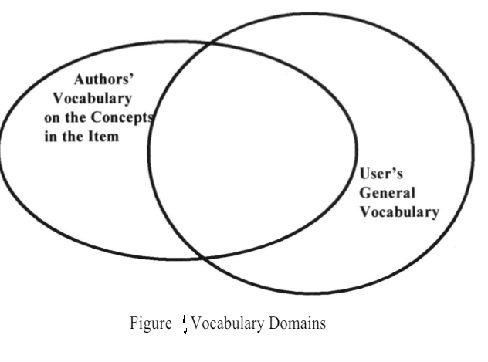
Objectives of Information Retrieval Systems
A limited knowledge of the vocabulary associated with a particular area along with lack of focus on exactly what information is needed leads to use of inaccurate and in some cases misleading search terms.
Users usually start with simple queries that suffer from failure rates approaching 50%.
Thus, an Information Retrieval System must provide tools to help overcome the search specification problems discussed above

Slide 18
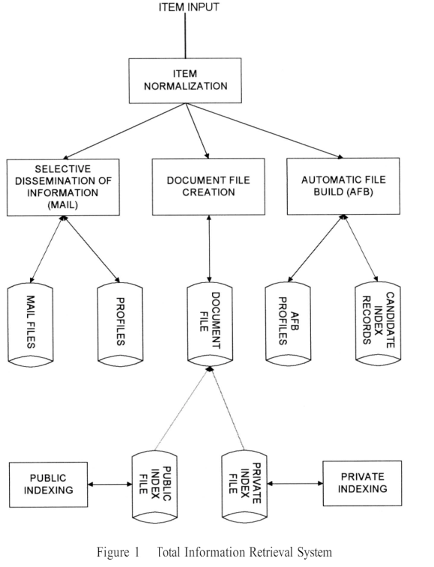
Functional Overview
The total information storage and retrieval system consists of four major functional processes:
  Item Normalization
  Selective dissemination of information ( i.e. Mail)
  Archival Document Database Search
  Index database search along with Automatic File Build Process
The next figure shows the logical view of these capabilities in a single integrated information retrieval system.

Slide 19
Item Normalization
The first step in any integrated system is to normalize the incoming items to a standard format.
Item normalization provides logical restructuring of the item.
Additional operations are needed to create a searchable data structure:
  identification of processing tokens (e.g., words),
  characterization of the tokens (categorizing the individual units of a sequence)
  stemming (e.g., removing word endings) of the tokens
The processing tokens and their characterization are used to define the searchable text from the total received text.

Slide 20
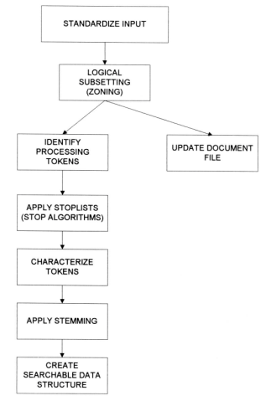
Item Normalization
The following figure shows the normalization process.

Slide 21
Item Normalization
Standardizing the input takes the different external formats of input data and performs the translation to the formats acceptable to the system (eg: translation of foreign languages into Unicode)
One standard encoding that covers English, French, Spanish, etc. is ISO-Latin
Multimedia adds an extra dimension to the normalization Process.
If the input is video the likely digital standards will be either MPEG-2, MPEG-1, AVI or Real Media
MPEG (Motion Picture Expert Group) standards are the most universal standards for higher quality video where Real Media is the most common standard for lower quality video being used on the Internet
Audio standards are typically WAV or Real Media (Real Audio).
Images vary from JPEG to BMP.

Slide 22
Item Normalization
The next process is to parse the item into logical sub-divisions that have meaning to the user. This process, called “Zoning”
A typical item is sub-divided into zones, which may overlap and can be hierarchical, such as Title, Author, Abstract, Main Text, Conclusion, and References.
The term “Zone” was selected over field because of the variable length nature of the data identified and because it is a logical sub-division of the total item, whereas the term “fields” implies independence
This categorization helps in organizing and managing data efficiently.

Slide 23
Item Normalization
Identification involves recognizing these tokens within the categorized information.
Once identified, the information (tokens) and their associated zones are stored in a way that allows for easy retrieval and management.
Users can perform searches that are restricted to specific zones or categories.
Once a search is complete, the user wants to efficiently review the results to locate the needed information. A major limitation to the user is the size of the display screen which constrains the number of items that are visible for review.

Slide 24
Item Normalization
To optimize the number of items reviewed per display screen, the user wants to display the minimum data required from each item to allow determination of the possible relevance of that item.
Quite often the user will only display zones such as the Title or Title and Abstract.
This allows multiple items to be displayed per screen. The user can expand those items of potential interest to see the complete text.

Slide 25
Item Normalization
Once the standardization and zoning has been completed, information (i.e., words) that are used in the search process need to be identified in the item.
  The term processing token is used because a “word” is not the most efficient unit on which to base search structures.
The first step in identification of a processing token consists of determining a word.
Systems determine words by dividing input symbols into three classes:
  valid word symbols,
  inter-word symbols, and
  special processing symbols.
A word is defined as a contiguous set of word symbols bounded by inter-word symbols. (eg: of word symbols are Alphabetic characters and numbers, eg of inter-word symbols are: blanks, periods and semicolons)

Slide 26
Item Normalization
The significance of these symbols depends on the language being processed.
  For example, an apostrophe might be critical for representing foreign names accurately in a database, even if it's of minimal importance in English when used for possessives.
When designing text processing systems, decisions about which inter-word symbols to prioritize are based on the required accuracy of searches and specific language characteristics.

Slide 27
Item Normalization
Finally there are some symbols that may require special processing.
  A hyphen can be used many ways, often left to the taste and judgment of the writer
when a hyphen (or other special symbol) is detected a set of rules are executed to determine what action is to be taken generating one or more processing tokens

Slide 28
Item Normalization
Stop List/Algorithm is applied to the list of potential processing tokens.
  Objective of Stop function: To save system resources by eliminating from the set of searchable processing tokens those that have little value to the system.
  They consist of words or terms that are excluded from being indexed or considered in search queries due to their frequent occurrence or lack of semantic value in relation to the search context
  Stop lists help filter out words that are extremely common across documents (like "the", "and", "is") but carry little semantic meaning. Including these words in search queries could lead to irrelevant results.
  By excluding these words from indexing and search operations, stop lists reduce the size of indexes and improve the efficiency of search queries.

Slide 29
Item Normalization
According to Ziph's (Ziph-49) hypothesis, most unique words only appear a few times when examining the frequency of recurrence of these terms over a corpus of objects.
Zipf's law states that in a given text or corpus, the frequency of any word is inversely proportional to its rank in the frequency table.
The rank-frequency law of Ziph is:
  Frequency * Rank = constant
    where
      Frequency is the number of times a word occurs and
      rank is the rank order of the word.

Slide 30
Item Normalization
The next step in finalizing on processing tokens is identification of any specific word characteristics (feature) .
The feature helps systems distinguish between different meanings of a given word. This includes a morphological examination of the part of speech of the processing token.
For example, for the word "plane":
  As an adjective: "level or flat"
  As a noun: "aircraft or facet"
  As a verb: "the act of smoothing or evening"
Another example of characterization is if upper case should be preserved

Slide 31
Item Normalization
Once the potential processing token has been identified and characterized, most systems apply stemming algorithms to normalize the token to a standard semantic representation.
  Stemming is a process where words are reduced to their base or root form, which helps in grouping together variants of words that have the same meaning
By reducing words to their stems, stemming helps improve the precision of search queries. For example, searching for "run" might retrieve documents containing "running" or "runner" because they share the same root.
Stemming standardizes tokens to a common form, reducing the number of unique terms the system needs to handle. This can simplify indexing and searching processes.
By reducing the number of unique terms, stemming can decrease computational overhead and memory usage associated with processing and storing text data
Once the processing tokens have been finalized based upon the stemming algorithm, they are used as updates to the searchable data structure.

Slide 32
Selective Dissemination of Information
The Selective Dissemination (spreading) of Information (Mail) Process provides the capability to dynamically compare newly received items in the information system against standing statements of interest of users and deliver the item to those users whose statement of interest matches the contents of the item.
The Mail process is composed of the search process, user statements of interest (Profiles) and user mail files.

Slide 33
Selective Dissemination of Information
Search Process: This component compares each incoming item against every user's profile.
User Profiles (Statements of Interest): Profiles contain broad search statements and specify which mail files should receive matching documents.
User Mail Files: These files store items that match the user profiles and are typically viewed in the order of receipt.

Slide 34
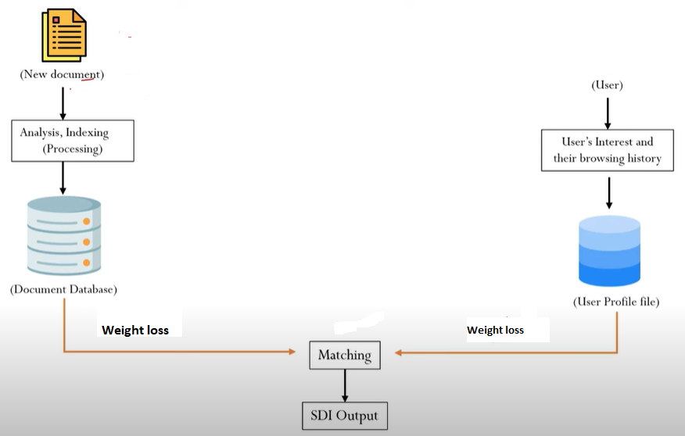
Selective Dissemination of Information

Slide 35
Selective Dissemination of Information
User search profiles (Push system) are different than ad hoc queries (pull system) in that they contain significantly more search terms (10 to 100 times more terms) and cover a wider range of interests.
These profiles define all the areas in which a user is interested versus an ad hoc query which is frequently focused to answer a specific question.
It has been shown in recent studies that automatically expanded user profiles perform significantly better than human generated profiles

Slide 36
Document Database Search
The Document Database Search Process provides the capability for a query to search against all items received by the system.
The Document Database Search process is composed of the search process, user entered queries (typically ad hoc queries) and the document database which contains all items that have been received, processed and stored by the system.
Any search for information that has already been processed into the system can be considered a “retrospective” search for information.

Slide 37
Document Database Search
Searches can cover a wide range of time periods, not necessarily limited to recent items.
The document database typically holds a vast amount of data spanning extensive periods, sometimes containing hundreds of millions of items.
Items in the Document Database are usually not edited once received, reflecting their original state when processed.
  Due to the diminishing value of information over time, databases are often partitioned by time to facilitate archiving and efficient retrieval.

Slide 38
Index Database Search
A user may want to save the interested item for future reference. This is accomplished via the Index Process.
The user can logically store an item in a file along with additional index terms and descriptive text the user wants to associate with the item.
A good analogy to an index file is the card catalog in a library
The index database search Process provides the capability to create indexes and search them.

Slide 39
Index Database Search
The system also provides the capability to search the index and then search the items referenced by the index records that satisfied the index portion of the query. This Process is called a Combined File Search.
In an ideal system the index record could reference portions of items versus the total item

Slide 40
Index Database Search
Two classes of Index files: Public and Private
  Every user can have one or more Private Index Files leading to a very large number of files
  Private Index File
    References only a small subset of the total number of items in the Document Database.
    Typically have very limited access lists.
  Public Index Files
    Maintained by professional library services personnel and typically index every item in the Document Database.
    Have access lists that allow any one to search and retrieve data.

Slide 41
Index Database Search
To assist the users in generating indexes, especially the professional indexers, the system provides a process called Automatic File Build.
  This capability processes selected incoming documents and automatically determine potential indexing for the item.
The capability to create Private and Public Index Files is frequently implemented via a Structured DBMS

Slide 42
Multimedia Database Search
From a system viewpoint, the multimedia data is an addition to the Information Retrieval System's current structures rather than conceptually its own data structure.
  It will reside almost entirely in the area described as the Document Database.
The specialized indexes to allow search of the multi-media (e.g., vectors representing video and still images, text created by audio transcription) will be augmented search structures

Slide 43
Multimedia Database Search
The correlation between the multimedia and the textual domains will be either via Time or Positional synchronization.
  Time synchronization is an ex. of transcribed text from audio or composite video sources
  Positional synchronization is where the multimedia is localized by a hyperlink in a textual item.

Slide 44
Relationship to Database Management Systems
There are two major categories of systems available to process items: Information Retrieval Systems and Data Base Management Systems
  IRS are designed to handle "information" items, which are characterized as fuzzy text. "Fuzzy" here refers to the lack of strict standards or controls on how the information is created.
  DBMS are optimized for handling "structured" data, which consists of well-defined facts typically organized into tables.

Slide 45
Relationship to Database Management Systems
IRS deal with diverse vocabulary and styles since creators of information items may use different terminology and approaches.
Users of IRS need to consider various search term possibilities due to the ambiguity and diversity of language used in information items.
Each attribute within a table in DBMS has a semantic description that clearly defines its meaning, such as "employee name" or "employee salary."

Slide 46
Relationship to Database Management Systems
The search results from IRS are often presented in relevance-ranked order, using features like relevance feedback to help refine searches.
Queries in DBMS yield specific results in a tabular format, making it easier for users to retrieve desired information.
DBMS software is used to store “information.”
  DBMS lack the ranking and relevance feedback features found in IRS, which are critical for handling fuzzy, unstructured information effectively.

Slide 47
Relationship to Database Management Systems
It is also possible to have structured data used in an information system (such as TOPIC).
  When this occurs, the user needs to be extremely resourceful in order to get the system to deliver the management data and reports that are easily accessible in a database management system.
To take advantage of each other's advantages, DBMS and IRS must be integrated.
  One of the first commercial databases to integrate the two systems into a single view is the INQUIRE DBMS
  A more current example is the ORACLE DBMS that now offers an imbedded capability called CONVECTIS, which is an informational retrieval system that uses a comprehensive thesaurus which provides the basis to generate “themes” for a particular item.
  The INFORMIX DBMS has the ability to link to RetrievalWare to provide integration of structured data and information along with functions associated with Information Retrieval Systems.

Slide 48
Digital Libraries and Data Warehouses
Two other systems frequently described in the context of information retrieval are Digital Libraries and Data Warehouses (or DataMarts).
There is significant overlap between these two systems and an Information Storage and Retrieval System.
All three systems are repositories of information and their primary goal is to satisfy user information needs.

Slide 49
Digital Libraries and Data Warehouses
Information Retrieval Systems (IRS) are designed to store and retrieve information based on user queries. They have evolved significantly from traditional library card catalogs to digital systems capable of handling vast amounts of electronic data. Their primary goal is to satisfy user information needs efficiently.
Digital Libraries are collections of digital materials accessible via the Internet. They aim to provide electronic access to information previously stored in physical formats like books, journals, and other media. The transition to digital formats allows for easier searchability and access, although challenges such as indexing standards and the preservation of digital information over time remain.
Data Warehouses are primarily used in the commercial sector to manage and analyze large volumes of structured data. They serve as central repositories that integrate data from different sources within an organization. Data warehouses facilitate decision-making by providing tools for data manipulation, analysis, and reporting. Data mining, a process within data warehouses, involves discovering patterns and relationships in data that were not initially apparent.

Slide 50
Digital Libraries and Data Warehouses
While there is overlap among Information Retrieval Systems, Digital Libraries, and Data Warehouses in terms of their goal to store and retrieve information, they differ in scope and focus:
  Information Retrieval Systems focus on textual data and user queries.
    Information Retrieval Systems continue to evolve with advancements in search algorithms and handling of diverse data types
  Digital Libraries manage digital collections of various media types and emphasize electronic access and preservation.
    Indexing is one of the critical disciplines in library science and significant effort has gone into the establishment of indexing and cataloging standards. Migration of many of the library products to a digital format introduces both opportunities and challenges:
      Converting existing hardcopy materials into digital formats while preserving their integrity and ensuring accessibility.
      Addressing issues related to copyright and intellectual property rights, especially in a digital context where laws and regulations vary globally.
  Data Warehouses primarily handle structured data for decision support and often include data mining capabilities to uncover hidden patterns.

Slide 51
Information Retrieval System Capabilities
Search Capabilties
Browse Capabilities
Miscellaneous Capabilities

Slide 52
Search Capabilities
The objective of the search capability is to allow for a connecting between a user’s specified need and the items in the information database that will answer that need.
  This statement can be composed of natural language text and/or query terms with Boolean logic indicators.
Some systems allow users to indicate the importance of search terms using a numeric value between 0.0 and 1.0.

Slide 53
Search Capabilities
This weighting helps prioritize certain terms over others when retrieving relevant items.
For example, in the query
  "Find articles that discuss automobile emissions(.9) or sulfur dioxide(.3) on the farming industry,"
The system would understand that automobile emissions are more critical than discussions on sulfur dioxide for ranking purposes.
The search statement may apply to the complete item or contain additional parameters.
  Parameters can restrict the search to specific parts or zones within an item, which helps improve relevance by avoiding retrieval of non-relevant portions. This can be particularly useful in larger documents where searching within specific sections (passage searching) enhances precision.

Slide 54
Search Capabilities
Based upon the algorithms used in a system many different functions are associated with the system’s understanding the search statement.
The functions define the relationships between the terms in the search statement (e.g., Boolean, Natural Language, Proximity, Contiguous Word Phrases, and Fuzzy Searches) the interpretation of a particular word (e.g., Term Masking, Numeric and Date Range, Contiguous Word Phrases, and Concept/Thesaurus expansion).
The terms "processing token," "word," and "term" are used interchangeably or contextually to refer to units that are searchable within documents.

Slide 55
Boolean Logic
It allows a user to logically relate multiple concepts together to define what information is needed.
Boolean functions apply to processing tokens identified anywhere within an item
Typical Boolean operators are AND, OR and NOT, and are implemented using intersection, set union and set difference procedures.
Placing portions of the search statement in parentheses are used to overtly specify the order of Boolean operations (i.e., nesting function).

Slide 56
Boolean Logic
If parentheses are not used, the system follows a default precedence ordering of operations (e.g., typically NOT then AND then OR).
Queries are processed Left to Right unless parentheses are included.
A special type of Boolean search is called “M of N” logic.
  The user lists a set of possible search terms and identifies, as acceptable, any item that contains a subset of the terms.

Slide 57
Boolean Logic
Ex: For example, “Find any item containing any two of the following terms: “AA,” “BB,” “CC.” This can be expanded into a Boolean search that performs an AND between all combinations of two terms and “OR”s the results together ((AA AND BB) or (AA AND CC) or (BB AND CC)).
Most information retrieval systems allow Boolean operations and natural language interfaces

Slide 58
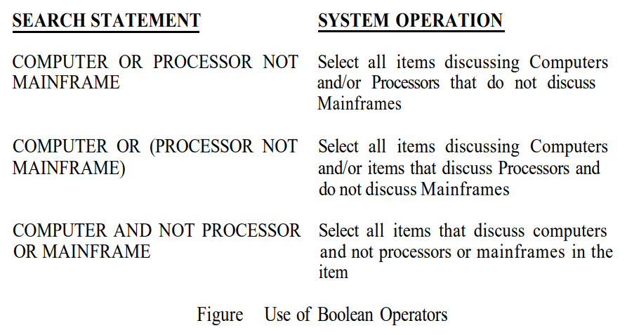
Boolean Logic
Some search examples and their meanings are as follows:

Slide 59
Proximity
Proximity is used to restrict the distance allowed within an item between two search terms.
The semantic concept is that the closer two terms are found in a text, the more likely they are related in the description of a particular concept.
Proximity is used to increase the precision of a search.
  If the terms COMPUTER and DESIGN are found within a few words of each other then the item is more likely to be discussing the design of computers than if the words are paragraphs apart.

Slide 60
Proximity
The typical format for proximity is:
  TERM1 within “m” “units” of TERM2
    The distance operator “m” is an integer number and units are in Characters, Words, Sentences, or Paragraphs.
For items containing imbedded images (e.g., digital photographs), text between the images could help in precision when the objective is in locating a certain image.
The proximity relationship contains a direction operator indicating the direction (before or after) that the second term must be found within the number of units specified. Default is either direction.

Slide 61
Proximity
A special case of the Proximity operator is the Adjacent (ADJ) operator that normally has a distance operator of one and a forward only direction.
Another special case is where the distance is set to zero meaning within the same semantic unit.

Slide 62
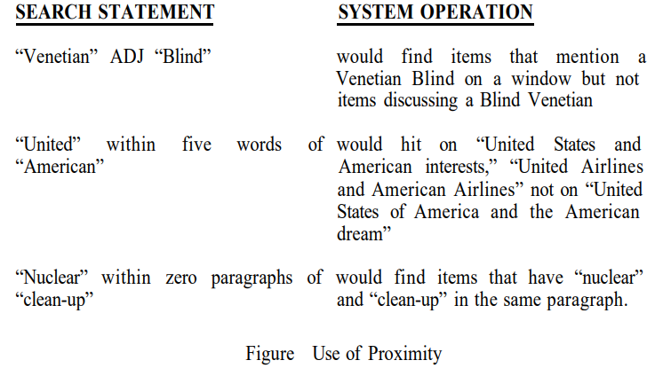
Proximity
Some proximity search statement examples and their meanings are given in following figure:

Slide 63
Contiguous Word Phrases
A Contiguous Word Phrase (CWP) can be used as a unique search operator in addition to a query word.
A Contiguous Word Phrase is two or more words that are treated as a single semantic unit.
An example of a CWP is “United States of America.”
It is four words that specify a search term representing a single specific semantic concept (a country).

Slide 64
Contiguous Word Phrases
A contiguous word phrase also acts like a special search operator that is similar to the proximity (Adjacency) operator but allows for additional specificity.
If two terms are specified, CWP and Proximity operator are identical.
For contiguous word phrases of more than two terms the only way of creating an equivalent search statement using proximity and Boolean operators is via nested Adjacencies which are not found in most commercial systems.
  This is because Proximity and Boolean operators are binary operators but contiguous word phrases are an “N”ary operator where “N” is the number of words in the CWP.

Slide 65
Contiguous Word Phrases
Contiguous Word Phrases are called Literal Strings in WAIS (Wide Area Information Servers) and Exact Phrases in Retrieval Ware.
In WAIS multiple Adjacency (ADJ) operators are used to define a Literal String (e.g., “United” ADJ “States” ADJ “of” ADJ “America”).

Slide 66
Fuzzy Searches
Fuzzy searching is a technique used to find words that are similar to the search term, even if they are not an exact match.
It helps in locating terms with minor spelling errors or variations.
Fuzzy searches include variations of a search term based on spelling similarity. For example, searching for “computer” might also return results like “compiter,” “conputer,” and “computter.”

Slide 67
Fuzzy Searches
This approach increases recall (finding more relevant results) but decreases precision (risk of retrieving irrelevant results). This is because it might include terms that are close but not exactly what you were searching for.
In systems that rank search results, words that resemble the search term more closely might be given higher ranks. For instance, “computer” will be ranked higher than “commuter,” especially if the latter is an entirely different word with a different meaning.

Slide 68
Fuzzy Searches
Fuzzy searches can expand a query by including other terms with similar spellings. The expansion might be limited by specifying the maximum number of similar terms.
The concept of “closest” (Heuristic Function) is used to determine which terms to include. This function can vary depending on the system.
Fuzzy searching has its maximum utilization in systems that accept items that have been Optical Character Read (OCR)

Slide 69
Fuzzy Searches
In the OCR process a hardcopy item is scanned into a binary image.
The OCR process is a pattern recognition process that segments the scanned in image into meaningful subregions.
The OCR process will then determine the character and translate it to an internal computer encoding (ex: ASCII or other)
OCR can introduce errors due to imperfections in the scanned image or limitations in character recognition accuracy.
Typically, OCR systems achieve high accuracy (90-99%), but errors are still common, especially if the quality of the original document is poor.
Role of Fuzzy Searching in OCR: Fuzzy searching helps in retrieving information from OCR-processed text by compensating for character recognition errors. It allows users to find relevant documents despite these errors.

Slide 70
Term Masking
Term masking is a technique used in search systems to handle variations in search terms by allowing some flexibility in matching.
Instead of requiring an exact match for a search query, term masking lets you specify a pattern that can match multiple possible terms.
This is particularly useful when a search system doesn't use advanced stemming algorithms or when it uses only simple stemming.

Slide 71
Term Masking
Types of Term Masking:
  Fixed Length Masking
  Variable Length Masking
Fixed Length Masking: This involves masking a specific position in a word, allowing any character in that position or the absence of a character there.
For instance, if you're searching for a term where the third character is masked, it would match words regardless of what character is in that third position or even if there is no character in that position.
  Example: Suppose you want to find words where the third character is unspecified. The query "HE$LO" could match "HELLO" or "HEALO", “HELO” depending on how the system is set up. This type of masking is less common and often not critical for most systems.

Slide 72

Term Masking
Variable Length Masking: Variable length “don’t cares” allows masking of any number of characters within a processing token.
The masking may be in the front, at the end, at both front and end, or imbedded.

Slide 73
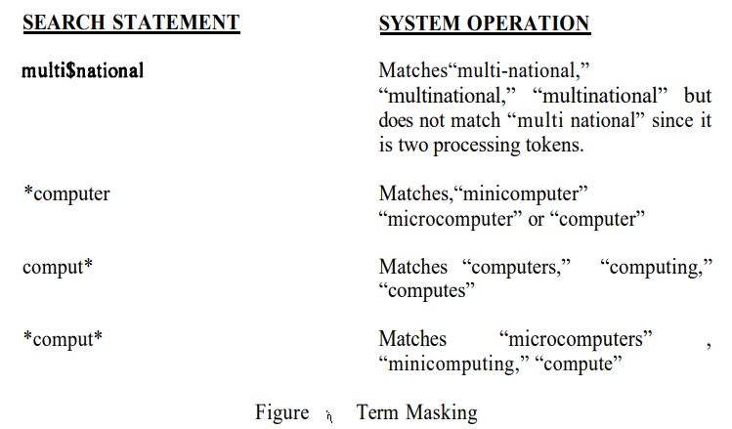
Term Masking

Slide 74
Numeric and Date Ranges
Term masking is useful when applied to words, but does not work for finding ranges of numbers or numeric dates.
  Using a term like "125*" will only find numbers that start with "125" (e.g., "125," "1254," "12556"). It will not find numbers like "130" or "120" because they do not start with "125.“
  Similarly, term masking won’t help in finding dates in a range, such as from "4/2/93" to "5/2/95." Term masking can’t interpret or process dates as ranges.

Slide 75
Numeric and Date Ranges
To handle numeric and date ranges effectively, systems use normalization processes to categorize and interpret data correctly
  During normalization, data is processed and converted into a format that makes it easier to perform operations like sorting or range queries. For example, words might be identified and classified as numbers or dates.
Once data is normalized, the system can apply specialized processing for numbers and dates.
  This makes it possible to run more complex searches than term masking alone.

Slide 76
Numeric and Date Ranges
With numeric or date normalization, users can input queries that specify ranges or conditions, such as:
  Numeric Ranges:
    "125-425": Finds numbers between 125 and 425, inclusive.
    ">125": Finds numbers greater than 125.
    "<233": Finds numbers less than 233.
  Date Ranges:
    "4/2/93-5/2/95": Finds dates from April 2, 1993, to May 2, 1995.
    ">4/2/93": Finds dates after April 2, 1993.
    "<5/2/95": Finds dates before May 2, 1995.
These types of queries are processed differently than simple term-based searches, allowing for more precise and useful results when dealing with numbers and dates.

Slide 77
Concept/Thesaurus Expansion
A Thesaurus helps in expanding search terms by finding synonyms or related words.
A thesaurus is typically a one-level or two-level expansion of a term to other terms that are similar in meaning
A Concept Class is a tree structure that expands each meaning of a word into potential concepts that are related to the initial term

Slide 78
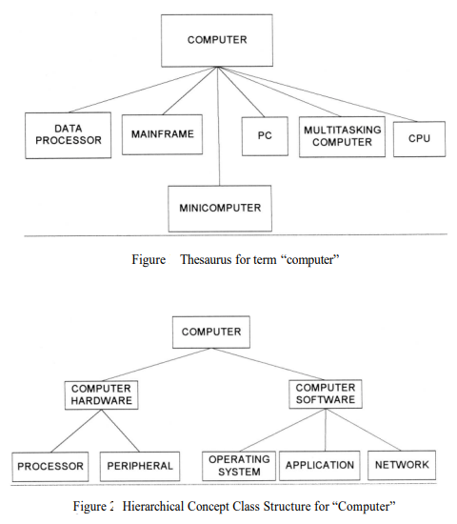
Concept/Thesaurus Expansion
An example of Thesaurus and Concept Class structures

Slide 79
Concept/Thesaurus Expansion
Thesauri is of two types:
  Semantic Thesaurus: Contains words and their semantically similar counterparts (words with similar meanings). For instance, if you search for "happy," a semantic thesaurus might suggest "joyful" or "content.“
  Statistical Thesaurus: Uses statistical methods to identify words that frequently occur together in a given dataset. This type is generated based on data patterns rather than predefined semantic relationships. For example, if "medical" and "doctor" frequently appear together in documents, the system identifies a strong statistical relationship between these terms.
  Thesauri help in broadening the search by including related terms, which can improve the recall of search results. However, this can sometimes reduce precision if unrelated terms are included.

Slide 80
Concept/Thesaurus Expansion
In some systems, users can manually select and add terms from thesauri or concept trees to refine their searches. This makes searches more specific to the demands of the user.
Both thesauri and concept class databases are powerful tools for enhancing search capabilities.
Thesauri help in expanding terms based on semantic similarities, while concept classes offer a structured approach to exploring and relating concepts. Both approaches have their strengths and are often used to balance recall and precision in search queries.

Slide 81
Natural Language Queries
Instead of using specific search terms and Boolean operators (like AND, OR, NOT) to search for information, you can type a full sentence or a prose statement (the ordinary language people use in speaking or writing) describing what you’re looking for.
  The longer the prose, the more accurate the results returned.
One major challenge is handling negation (like "Do not include..."). The system needs to correctly understand and exclude information that doesn't meet the criteria.
  Find for me all the items that discuss oil reserves and current attempts to find new oil reserves. Include any items that discuss the international financial aspects of the oil production process. Do not include items about the oil industry in the United States.
Systems are designed to find items similar to the ones described in the query, but excluding certain items that match part of the query is more complex.

Slide 82
Natural Language Queries
The system translates this natural language input into a format it can process.
The difficulty lies in correctly interpreting and applying the negation.
When this capability has been made available, users have a tendency to enter sentence fragments that reflect their search need rather than complete sentences
This is predictable because the users want to minimize use of the human resource (their time).

Slide 83
Natural Language Queries
The likely input for the above example is:
  oil reserves and attempts to find new oil reserves, international financial aspects of oil production, not United States oil industry
Using the same search statement, a Boolean query attempting to find the same information might appear:
  (“locate” AND “new” and “oil reserves”) OR (“international” AND “financ*” AND “oil production”) NOT (“oil industry” AND “United States”)

Slide 84
Natural Language Queries
Associated with natural language queries is a function called relevance feedback. The natural language does not have to be input by the user but just identified by the user
  Relevance feedback feature allows users to refine searches based on items they find relevant, even if they don’t input full sentences. Users can select relevant items or text segments, and the system adjusts its search accordingly.
To accommodate the negation function and provide users with a transition to the natural language systems, most commercial systems have a user interface that provides both a natural language and Boolean logic capability.

Slide 85
Natural Language Queries
Negation is handled by the Boolean portion of a search.
„ Natural language interfaces improve the recall of systems with a decrease in precision when negation is required.

